Slide 1
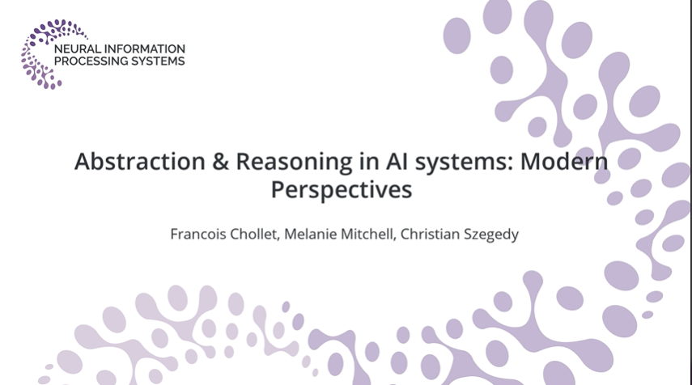

Slide 2
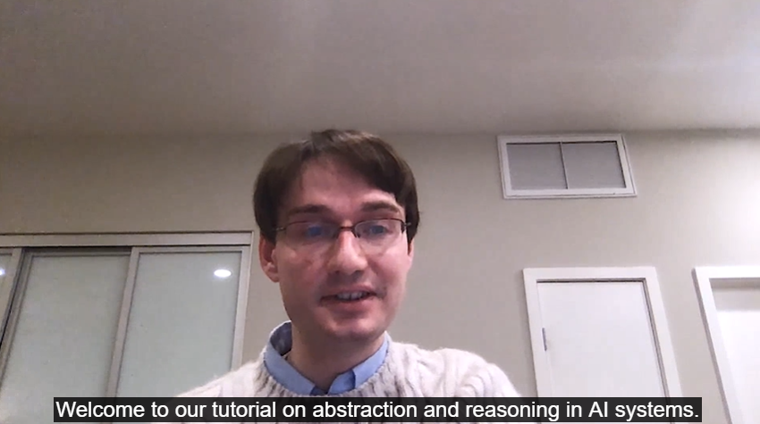
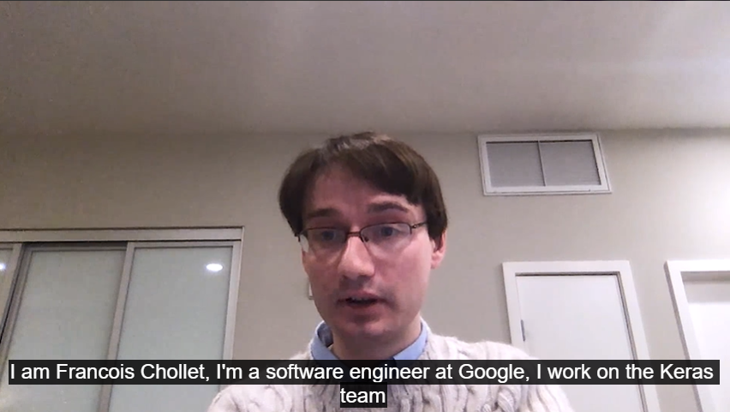

Slide 3
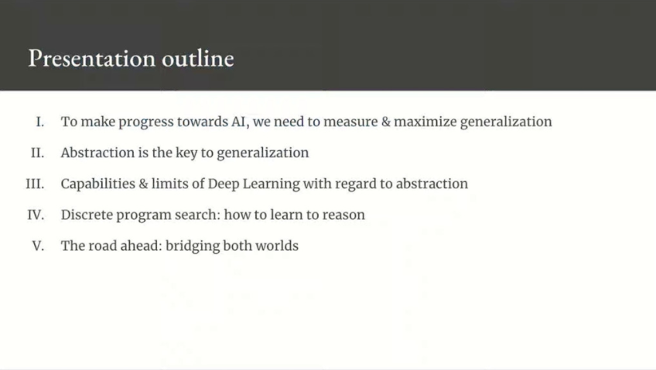
Notes:
Francois Chollet, Melanie Mitchell, Christian Szegedy | Abstraction & Reasoning in AI systems: Modern Perspectives · SlidesLive
https://slideslive.com/38935790/abstraction-reasoning-in-ai-systems-modern-perspectives

Slide 4
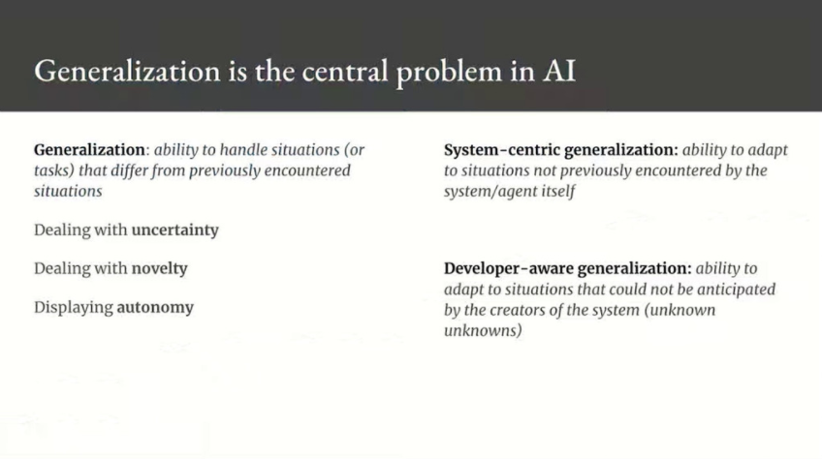
Notes:
System centric generalization is the definition we usually rely on when we do machine learning but it’s a much weaker form of generalization compared to developer aware generalization.
Developer aware generalization is synonym with autonomy and the ability to adapt to novelty without the help of a human engineer.

Slide 5
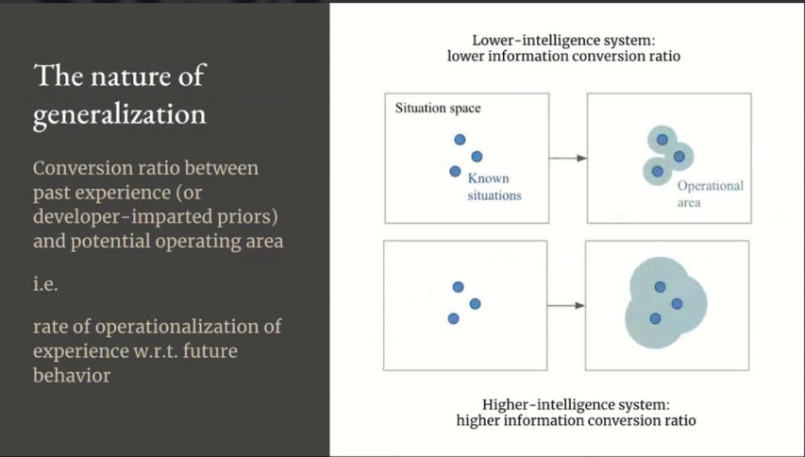
Notes:
Generalization characterizes the relationship between the information that you have, your priors as well as your past experience, and your operational area over the space of potential future situations that you might encounter, which feature uncertainty and novelty.
Generalization is the efficiency with which you operationalize past information to deal with the future, so you can interpret it as a kind of conversion ratio.

Slide 6
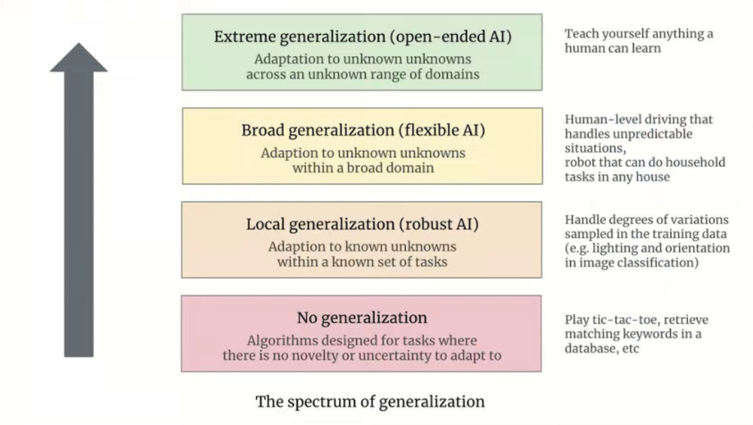
Notes:
Generalization is not a binary property of a system, it’s actually a spectrum : you can categorize AI systems by their level of generalization.
At the lower level, you have software systems which are static systems operating in a world without novelty or uncertainty.
At the second level you have robust AI which corresponds to the statistical learning definition of generalization : all of machine learning falls in this definition.
Flexible AI : ability to handle a broad domain of activity autonomously, including the ability to deal with situations and tasks that the creators of the system could not have anticipated : self driving falls in this category, and we are just starting to venture in this space.
Exterme generalization corresponds to open ended intelligence : a system capable of adapting to any task in any domain that the creator of the system could not have anticipated : that’s currently the exclusive domain of biological intelligence. This is still science fiction.

Slide 7
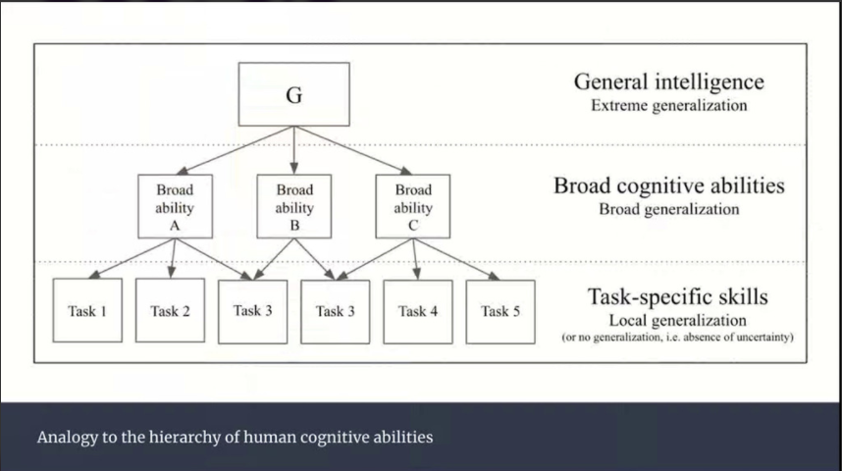
Notes:
This spectrum of generalization mirrors the structure of human cognitive abilities.

Slide 8
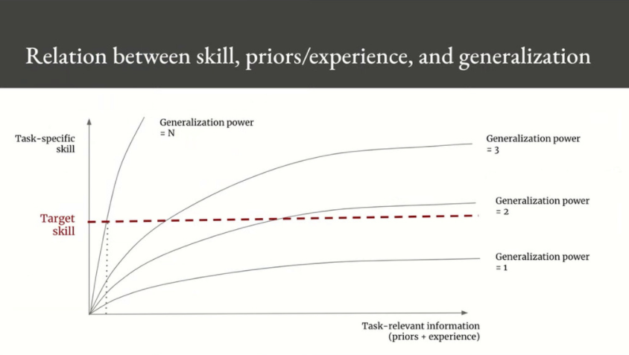
Notes:
The task specific skill exhibited by a given system tells you nothing about its intelligence, that is to say about its generalization power.
Because generalization is a relationship between what you can do, so your skill, and the information that you have about a task, your priors and experience.
And it’s always possible to buy skill for a system that has a given level of intelligence by providing the system more information about the task, which reduces uncertainty and novelty, and thus reduces the need for generalization.
And you do this either via more training data, or by using human intelligence to produce prexisting abstraction that you can hard code into your system (that’s what you call priors).
You can alway increase skill without increasing generalization power simply by reduing uncertainty and novelty.
So skill does not characterize intelligence.

Slide 9
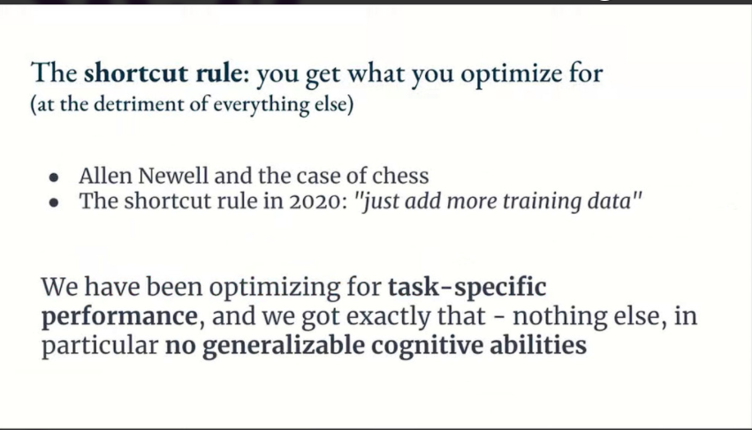
Notes:
If you start optimizing for a specific metric, then you will take shortcuts along every possible dimension that is not captured by your metric.
In AI, the shortcut rule means that if you focus on tasks-specific skill, you will achieve tasks-specific skill, but you will do so by taking shortcuts, and you will end up with a system that does not display generalizable cognitive abilities because skill is orthogonal to generalization power.
If you can generalize, then you can develop new skills by going from the general to the specific, but in reverse, there is no path from the specific to the general, and it’s not possible to come up with one specific task or one specific metric that requires broad cognitive abilities.
If you fix the task and it is known in advance and it is known on advance to the developers of the AI system, then you open the door to shortcuts.
Example : a previous goal was to solve chess, because chess in humas features memory, learning, reasoning, analysis and so on. So if you can solve chess, then surely you should be able to understand all the different cognitive mechanisms. We did solve chess eventually, but it turned out that solving chess did not teach us anything about human cognition because we had fixed the task and thereforce we took shortcuts.

Slide 10
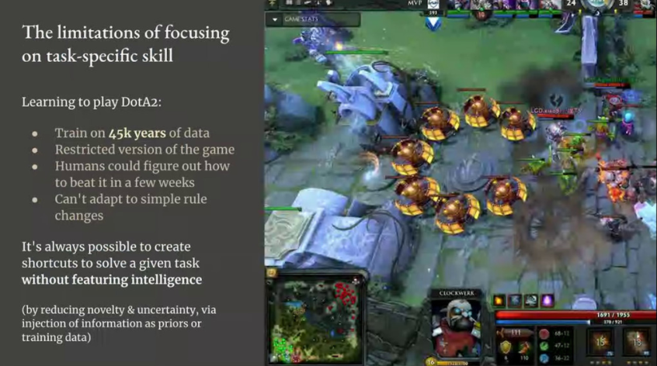
Notes:
The modern version of this story is to increase skill, task_specific skill, on a problem by adding more training data, which reduces the need for generalization power.
And it’s always possible to create shortcuts to solve a given taks without featuring intelligence, without increasing generalization power : you do that by reducing novelty and uncertainty via injection of information about the task, either as priors,or as training data.
In the limit, you can always achieve arbitrary skill on arbitrary problems without requiring any generalizable cognitive ability.
So you can always use deep learning or even just really a big hash table to solve an arbitrary task, but that requires either a tremendous amount of manual modeling or a tremendous amount of training data.
Example – learning ro play DotA : OpenAI trained a deep learning systel on 45 000 years of gameplay and the system was able to play at superhuman level in some respects but it was very brittle in the end. People very quickly figured out how to reliably beat it, and it could not adapt to simple rule changes, like introducing a new character in the game.
A human player adapts to this change instantly in a single game without expending any energy. But a deep learning system is going to need thousands of additional years of training data to adapt to a single such change, until the next smal variation shows up.

Slide 11
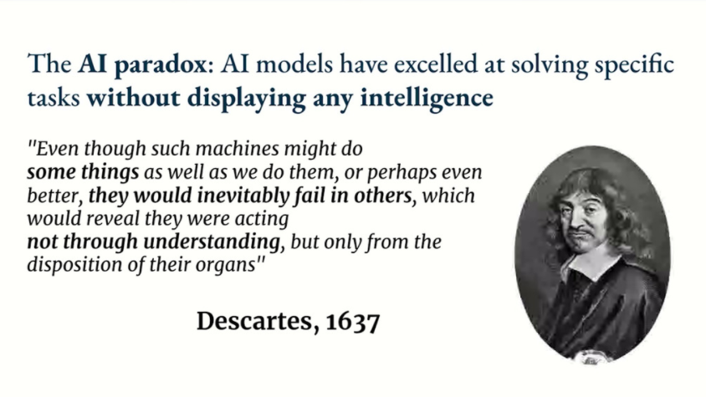
Notes:
This has been the history of articifial intelligence since the beginning.
Here is a quote from Descartes 400 years ago whoch really captures the essence of the difference between an intelligent agent and an automaton.
Descartes tells us that an automaton operationalizes abstractions that were provided by its creators.
But on the other hand an intelligent agent is able to produce its own abstractions and therefore it can adapt to any situation.
The automaton can only handle situations that match the abstractions that were imparted to it by its creators.
The generation of autonomous abstractions, which is intelligence, is orthogonal to the encoding and operationalization of preexisting human abstractions as we’re seeing in current AI systems.
And that’s true wether you provide these abstractions in the form of hard coded rules or in the form of training data : in both cases what you’re doing is providing a full description of the task, which removes the need for generalizatio,.
Intelligence is the ability to produce your own abstraction in order to generalize, and there is an immense gap between operationalizing preexisting abstraction and developing your own abstraction.
This difference is akin to the difference between creating cartoon characters and creating new lifeforms : training data for deep learning is analogous to motion capture for cartoon characters.

Slide 12
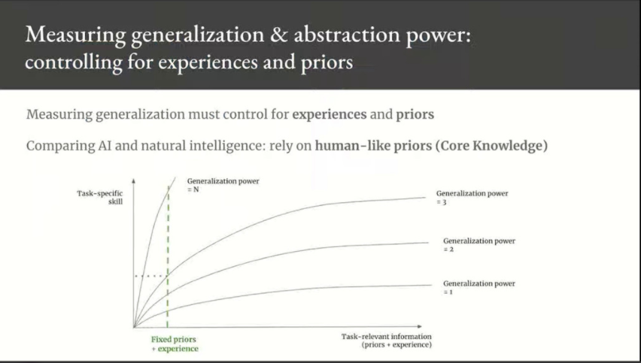
Notes:
If you’re interested in measuring generalization power, you should not look purely at skill, you should control for priors and experience.
And if you’re insterested specifically in comparing artificial intelligence to human intelligence, then you should standardize on a shared set of prioris, shared between AI and humans.
And that’s gonna be human cognitive prioris because that’s clearly fixed, and that’s something we call Core Knowledge.

Slide 13
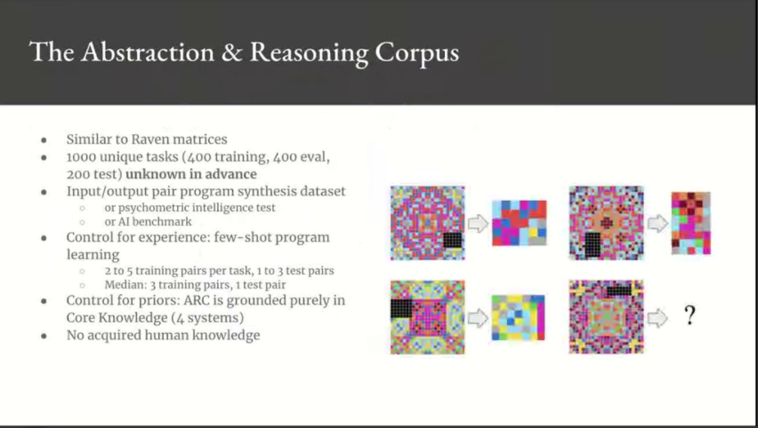
Notes:
The key idea of ARC is that every task that you see, in the test set in particular, is new. It’s only going to share abstract commonalities with previously seen tasks.
So you control for experience because every task is new and you’re doing few-shot program learning. For each task, you have to learn the task from just about thjree examples typically.
And you control for priors because ARC is purely grounded in Core Knowledge, so it doesn’t feature anything that is acquired through experience, like language for instance.
All tasks in ARC are constructed on top of four Core Knowledge priors : objectness, elementary geometry and topology, numbers, and agentness.
We ran a Kaggle challenge on this dataset in early 2020, and it produced several very interesting solutions, all based on program synthesis.

Slide 14
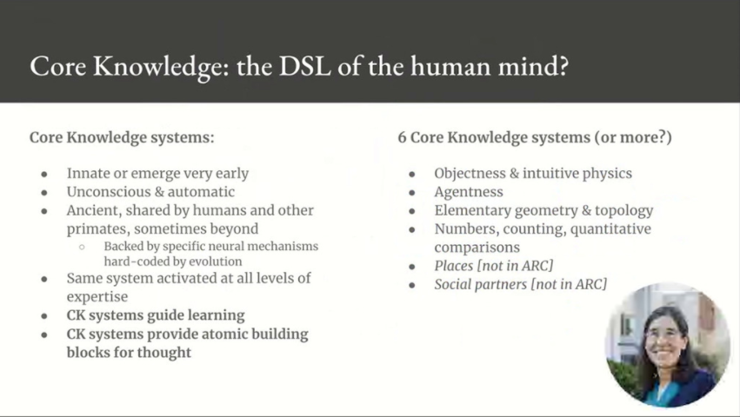
Notes:
Core Knowledge is basically the set of innate cognitive priors possessed by humans, which guide our ability to learn throughout our lives, which form the atomic building blocks of thinking.
This is based on work done primarily by Elizabeth Spelke from Harvard.
She identified six different Code Knowledge systems :
Objectness and elementary physics
Agentness and goal directness
Elementary geometry and topology
Numbers
Places
Social partners
Core Knowledge systems are innate, or at least they emerge very early, which is basically the same for all intents and purposes.
They’re ancient, so we find them in non human primates and you also find some of them in different animals, like birds for instance.

Slide 15
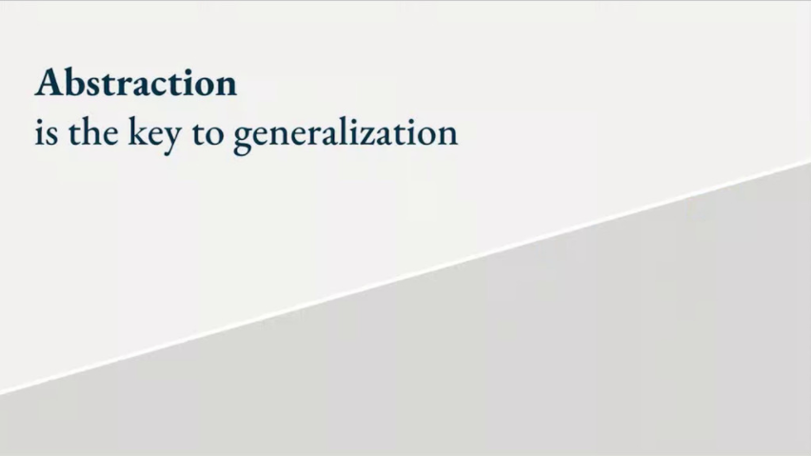
Notes:
By now you should have a pretty good idea why we should focus on achieving broad generalizable cognitive abilities rather than task specific skill, and this brings us to the problem of abstraction.
Abstraction and generalization are closely tied, because abstraction is the engine through wichi you produce generalization.

Slide 16
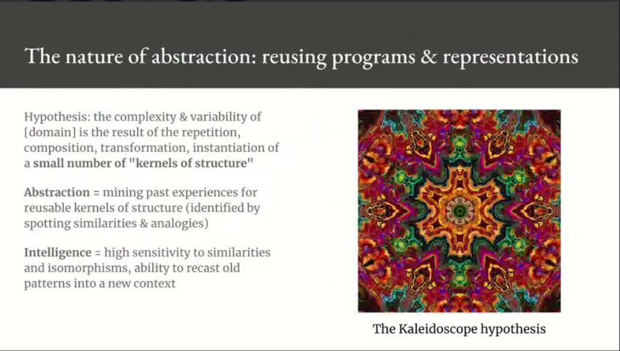
Notes:
An interesting observation about the universe which applies to pretty much any problem domain you can think of is that it is made of many different things that are all similar, all analogous to each other. So we are surrounded by isomorphisms and I call this the kaleidoscope hypothesis.
Generalization is the ability to mine the experience that you have to identify the bits that are reusable.
You extract these bits and you call them abstractions, and they take the form of programs and représentations, and you reuse them to make sense of novel situations.
So how do you identify reusable kernels of structure ?
Simply by noticing when two things are similar, by noticing analogies.
Because if something is repeated twice, then both instances of that thing must have a single origin, like in a kaleidoscope.
So intelligence, which is to say generalization power, is literally sensitivity to abstract analogies, and that’s in fact all there is to it.
Intelligence is sensitivity to analogies, so if you have very high sensitivity to analogies, you will be able to extract powerful abstractions from little experience, and you will be able to use these abstractions to operate in a maximally large area of future experience space.
You will be maximally efficient in converting past experience into the ability to handle future novelty.

Slide 17
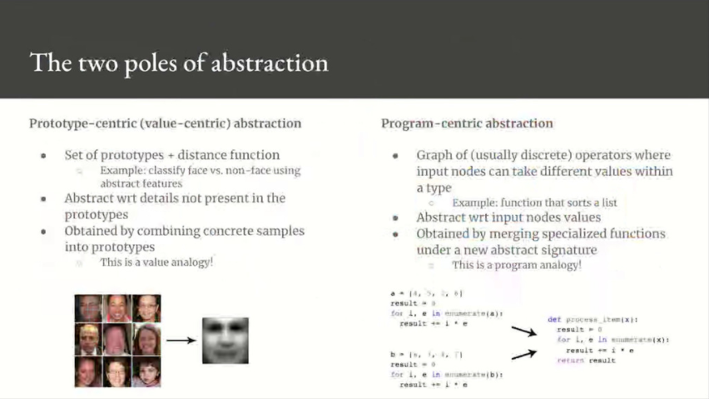
Notes:
I said these abstractions could take the form of a representation or a program, and that’s a reference to the two key categories of abstraction that we’re interested in this talk : value-centric abstraction and program-centric abstraction.
They’re pretty similar to each other : both of them are about comparing things and merging individual instances into common abstractions by eliminating certain details about these instances.
But there’s a key difference, which is that one of these types of abstraction operate over a continuous domain and the other operates over a discrete domain.
Value-centric abstraction is about comparing things via a continuous distance function, so it involves comparing two instances of an object with a distance functions, or expressing an instance in terms of prototypes which are basically abstract features. It’s similar to human perception, it’s similar to human intuition, pattern recognition. It’s also what you do in machine learning.
Program-centric abstraction, on the other hand, is about comparing discrete programs, which is to say graphs, and rather than computing distances you are looking for subgraph isomorphisms. That’s similar to human reasoning, planning. It’s also what software engineers do.

Slide 18
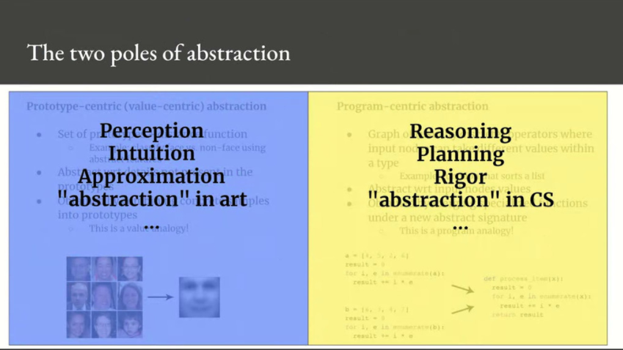
Notes:
Both forms of abstraction are driven by analogy, so analogy is the fundamental engine that produces abstraction.
It can be value aalogy where you compare two instances by value, or it can be program analogy where you compare the structure of two programs.
Value analogy is geometrically grounded, so you compare instances via a distance function, and you create abstractions by merging instances that are similar into a prototype.
Program analogy is topologically grounded, so you compare the structure of two graphs, and you create abstractions by merging instances that are isomorphic into an abstract program.
All intelligence arises from a combination of these two forms of abstraction.

Slide 19
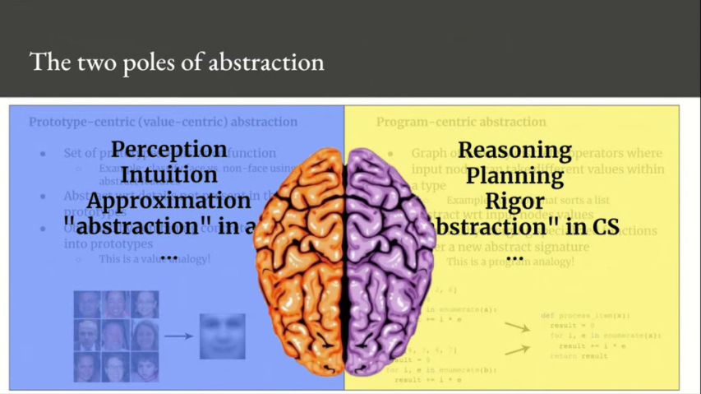
Notes:
You can remember them via the left brain versus right brain analogy , where on half is for perception, intuition, and the other half represents reasoning, planning, mathematics and so on (this is of course a metaphor, it’s not actually the way lateralization of cognitive function works).

Slide 20
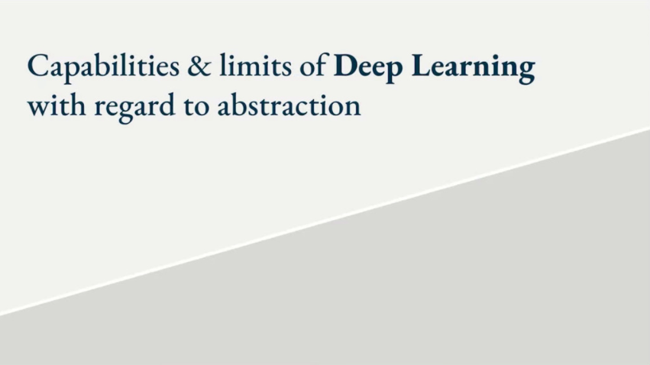
Notes:
Now let’s talk about Deep Learning

Slide 21
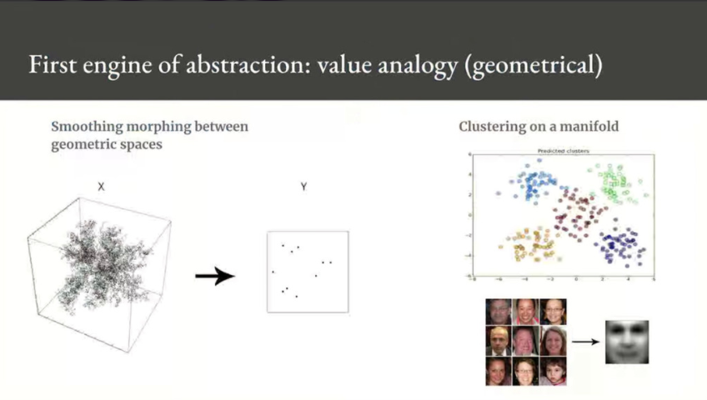
Notes:
Deep Learning excels at the first form of abstraction, which makes sense because deep learning models are continuous, in fact they are differentiable parametric models.
So it’s intuitive that you would be able to produce abstractions that are grounded in geometry using deep learning.
In supervised deep learning, what you’re doing is an analogy between two spaces. You have an input vector space and you have a target vector space which is usually much smaller, and you are learning a smooth geometric morphing between the two spaces point by point. So it’s a geometric analogy between two spaces : the deep learning model encodes this space to space analogy.
Deep learning is about relating samples to each other via a learned distance function, which implicitly defines a manifold.

Slide 22
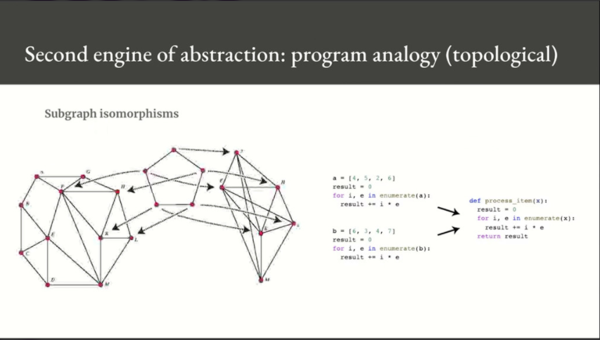
Notes:
You can contrast this with the second kind of abstraction, which is grounded in topology, which is all about comparing the structure of graphs and finding subgraph isomorphisms, and then abstracting them away.

Slide 23
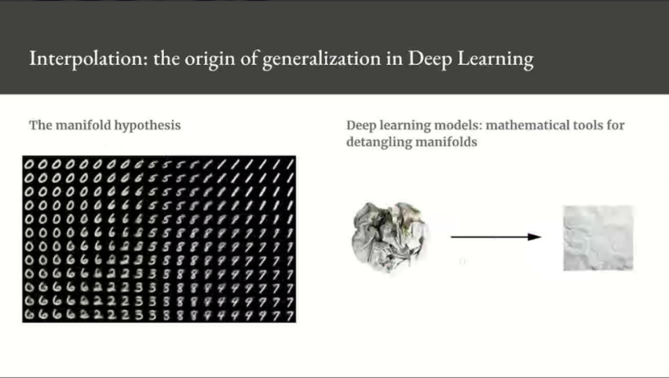
Notes:
Going back to value-based abstraction, it relates to the manifold hypothesis in machine learning.
The manifold hypothesis posits that all natural data lies on a low-dimensional manifold within the high-dimensional space where it is encoded, and as far as we know, it’s accurate for pretty much any perception problem.
The manifold hypothesis implies that within one of these manifolds, it’s always possible to interpolate between two inputs, that is to say to morph one input into another via a continuous path along which all points fall on the manifold.
The ability to interpolate between samples is the key to understanding generalization in deep learning, it’s the reason why deep learning works.
If you have data points that can be interpolated, then you can start making sense of points you’ve never seen before by relating them to other points that lie close to them on the manifold.
You can start to make sens of the totality of the space using only a sample the space, and that is generalization.

Slide 24
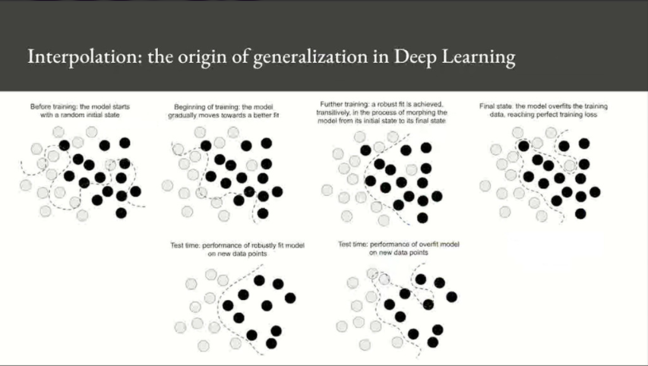
Notes:
A deep learning model is basically a very high dimensional curve with some constraints on its structure which originate from model architecture priors, and you fit this curve with gradient descent.
That curve has enough parameters that it could really fit anything.
And indeed, if you let your model train for long enough it will effectively end up purely memorizing its training data, it’s not gonna generalize at all.
However, because the data that you’re fitting forms a highly structured low dimensional manifold within the input space, and also because the fit happens gradually and smoothly over time as gradient descent progresses, there will be a transitive point during training at which the model will roughly approximate the natural manifold of the data, in between underfitting and overfitting.
And the curve learned by the model at that point will just happen to come close to moving along the actual latent manifold of data, so the model will be able to make sense of novel input via interpolation.
An important observation here is that the power of this model to generalize is actually much more a consequence of the natural structure of the data rather than the consequence of any property of the model.
You could say it’s partially a consequence of the gradient descent process, because the gradient descent process is gradual and smooth, but you will only be able to generalize if your data forms a manifold where points can be interpolated.
The more informative and the less noisy your features are, the better you will be able to generalize since your input space will be simpler and better structured.

Slide 25
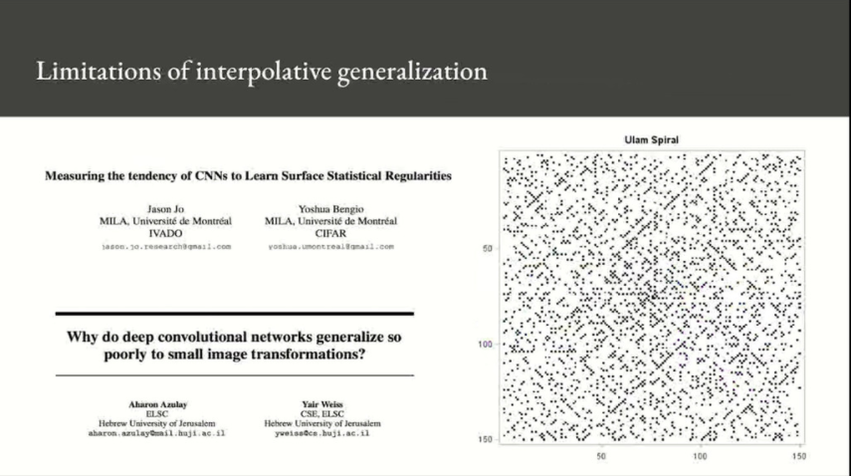
Notes:
This is very effective for perception problems, but it has limitations : it’s brittle, it’s sensitive to small perturbations.
That’s because it’s a point by point mapping between two spaces and if you shift one of the spaces slightly, the mapping that was learned breaks down.
That’s where you start seeing that topology-based abstraction is more powerful than geometry-based abstraction because distances are not robust to small perturbations but structure is robust to small perturbations.
And there’s an even bigger limitation, which is that for geometry-based abstraction to even be relevant, you need to be dealing with a continuous domain.
You cannot apply deep learning to discrete problems like sorting a list, for instance, or finding prime numbers, or you cannot apply it to, you know, 99% of software engineering problems.
You cannot solve these problems with continuous optimizations because they have a discrete structure, fundamentally.
You could always try embedding that discrete structure in a continuous manifold, but you couldn’t use that manifold for interpolation, so your continuous pareametric model could not generalize to things it has not seen before.
So in order to learn a useful embedding, you would need an exhaustive sampling of the problem space, you’d need to memorize the problem space, or at least generative grammar of the problem space.

Slide 26
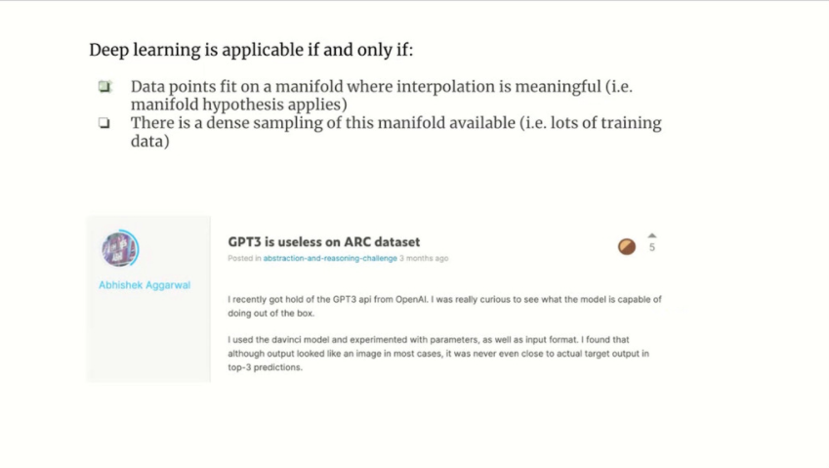
Notes:
The takeaway here is that in order for deep learning ro be relevant for a given problem, you need two things :
You need your problem to be interpolative in nature, so you need the manifold hypothesis to apply, because otherwise deep learning cannot generalize (it could memorize but it could not generalize), and that’s true for many problems, in particular any perception problem, but that’s not true for every problem
And second you need enough data to learn your manifold, and it’s always a lot of data, so you need a dense sampling of the distribution that you’re trying to learn
One interesting thing about ARC is that lots of people have tried using deep learning on ARC and no one has managed to achieve anything with it, not even solve a single test sample.
And that also applies to very large, pretrained models like GPT-3.
That’s because the ARC problems are not interpolative in nature, and you only have a few examples for each task.

Slide 27
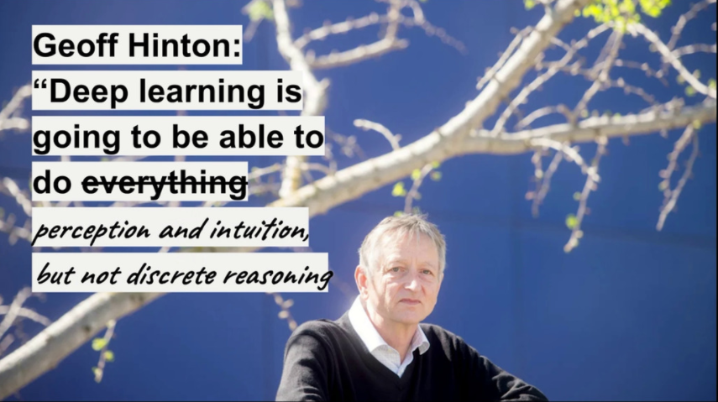
Notes:
Deep Learning is not gonna be able to solve everything, it’s only going to be able to solve problems that require value-centric abstraction, it cannot solve problems that require program-centric abstraction.
So anything a human can solve via perception and intuition, you can probably do with deep learning, assuming that you get a big enough dataset, but anything that require reasoning, planning, program-centric abstraction, you cannot really solve with deep learning, short of full memorization.

Slide 28
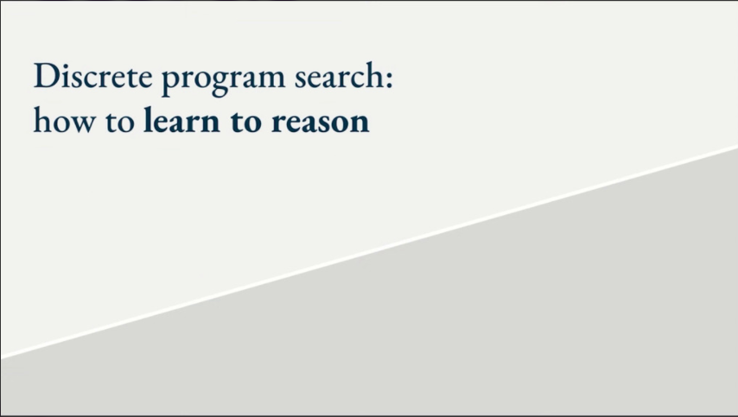
Notes:
How do you solve these problems like ARC, sorting a list, finding prime numbers, and so on, any reasoning and planning problem ?

Slide 29
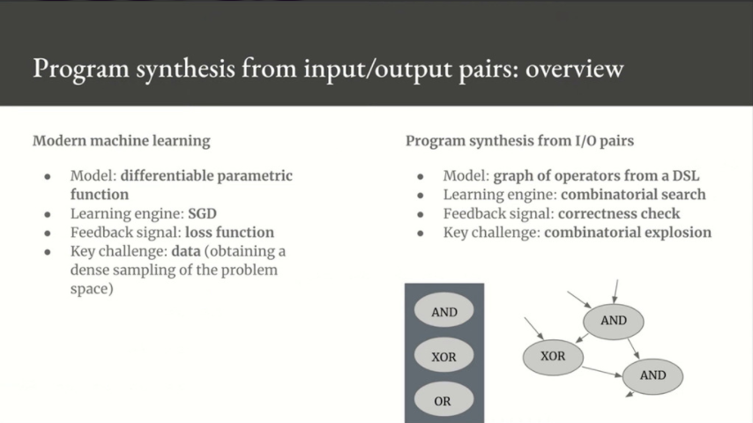
Notes:
The answer is simple : it’s program synthesis, which is to say combinatorial search over graphs of operators taken from a domain-specific language, a DSL.
So it’s a dicrete searhc over graphs, and there are many flavors of that, like genetic programming in particular, and you can draw an analogy between machine learning and program synthesis.
In machine learning, your model is a differentiable parametric function, and in program synthesis, it’s a graph of ops from a domain specific language.
In machine learning, your learning engine is stochastic gradient descent, and in program synthesis, it’s combinatorial search.
In machine learning, the key obstacle is that you need a dense sampling of your problem manifold, and in program synthesis, the key challenge is combinatorial explosion.
So you can use program synthesis to solve problems from very few examples, unlike deep learning, but the set of possible programs that you can build grows combinatorially with program size, so it makes it very, very expensive.

Slide 30
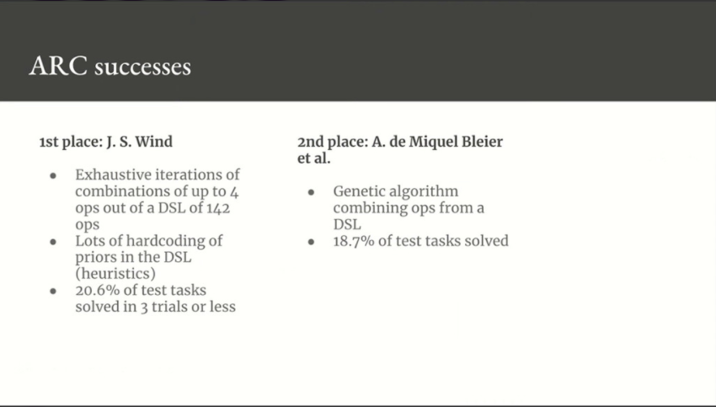
Notes:
Program synthesis, and in particular genetic programming, has been pretty successful on ARC, although it’s just baby steps.
All the top solutions all use roughly the same template : you have a DSL and you search over possible programs built from this DSL, and you use heuristics to make the search more efficient.
I want to stress that these systems are still extremely primitive, they make little to no effort to address the key problem of combinatorial explosion, they don not leverage program-centric abstraction at this time.
What they’re doing is really just combining hard-coded building block from the DSL with exhaustive search, which is not a very sophisticated algorithm.
Event though they’re very primitive, they remain infinitely more successful than deep learning on ARC problems.

Slide 31
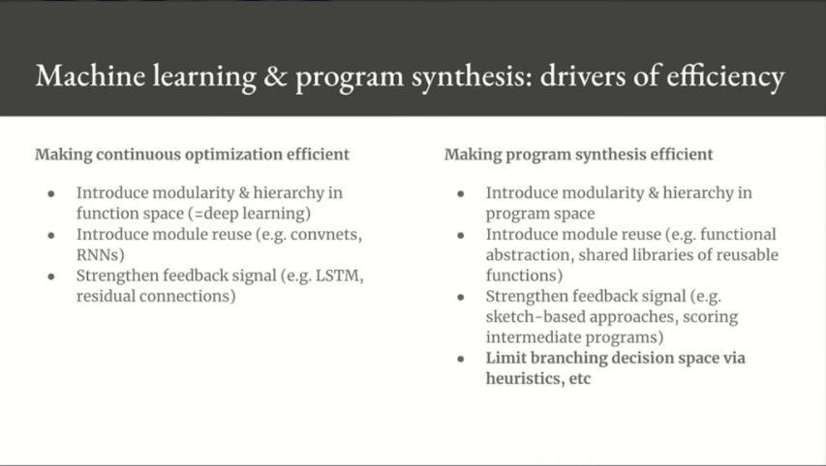
Notes:
One thing that’s super important is that if you want to use either continuous optimization or program synthesis in practice, you need to make them efficient.
And if you want to make something efficient, there’s a universal recipe, which is that you introduce modularity and hierarchy, and you introduce reuse, and « reuse » is another word for « abstraction ».
That’s basically universally true, and of course, it’s true for continuous optimization, so deep learning is what you get when you add modularity and hierarchy to continuous optimization, that is to say when you structure your parametric functions into deep stacks of layers, and further if you hard code abstract module reuse in continuous optimization, then you get deep learning architecture patterns.
For instance convolution is a hard coded module which abstracts away spatial position.
A RNN is likewise a module with a temporal « for » loop, so it hardcodes the fact that different time steps of your data should be processed by the same submodule, so it’s abstract with regard to the time axis.
This recipe of making something more efficient by introducing modularity, hierarchy, and reuse also holds true for discrete combinatorial optimization.
You can limit your search to programs that follow software architecture best practices, which tend to revolve around modularity and hierarchy, and then you can start introducing function reuse, which is the second type of abstraction that I mentioned, program-centric abstraction.
In general there are two tools at your disposal to make program synthesis efficient : there’s this abstract function reuse, and there’s also making smarter branching decisions when you’re searching over the program space : reduce program space in order to fight combinatorial explosion.
You can actually use deep learning there.

Slide 32
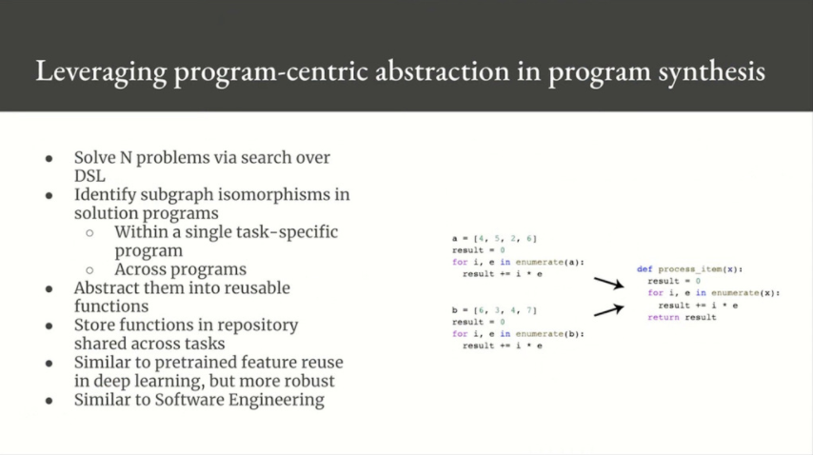
Notes:
Let’s talk briefly about symbolic module reuse, which is, again, program centric abstraction.
The general idea is that you start with a given DSL, and you run program search to solve various problems, like ARC tasks for example, so you generate solution programs, and then you start identifying subgraph isomorphisms, both within the program and across programs, and you abstract these subprograms away into reusable functions, and you add these functions back to the DSl, and you keep searching.
Now your search includes these abstract functions.
So this is very similar to software best practices, like reusing an open source library, for instance, and that’s one very important way to make program synthesis more efficient.
But there’s also a complementary and even more powerful way to improve program synthesis, and that is to merge program synthesis with deep learning, to levergae deep learning as a way to reduce the program search space and to fight combinatorial explosion.

Slide 33

Notes:
The fact that deep learning has not been used on ARC type problems so far doesn’t mean that it’s useless, at all.
I think it really has a rôle to play.
I said earlier that all intelligence is a combination of two forms of abstraction, and I don’t think that you can go very far with only one of these, I think you need to combine the two forms of abstraction in order to achieve their true potential.
And I think that’s what human intelligence is really good at. Human intelligence is really good at combining perception and intuition together with explicit reasoning. We combine value-centric abstraction with program-centric abstraction, and that’s really what makes us special.

Slide 34
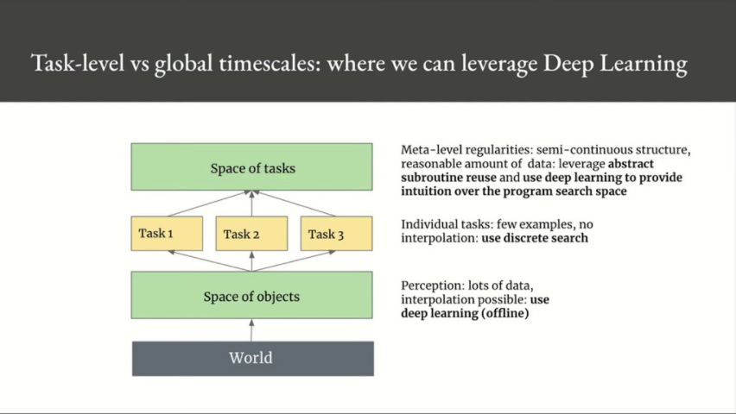
Notes:
I mentioned that in order to do deep learning, you need two things : you need an interpolative problem – you need the manifold hypothesis, and you need lots of data.
If you look at a single ARC task, it’s not interpolative, and you only have basically three examples so you cannot use deep learning.
But if you take a step lower down the scale and you look at the Core Knowledge priors that ARC tasks are built upon, each of them is actually interpolative in nature and could be learned from data. And of course, you can collect lots of data about them, so you could use deep learning at that level, at a level of serving as a perception layer that parses the world into discrete objects via core knowledge.
And if you take a step higher up the scale and you look at the space of all ARC tasks, then again you will find continuous dimensions of viability, so you can leverage interpolation to some extent over the space of tasks, you can use deep learning there as well to produce intuition over the structure of the space of tasks and the structure of the space of possible solution programs.

Slide 35
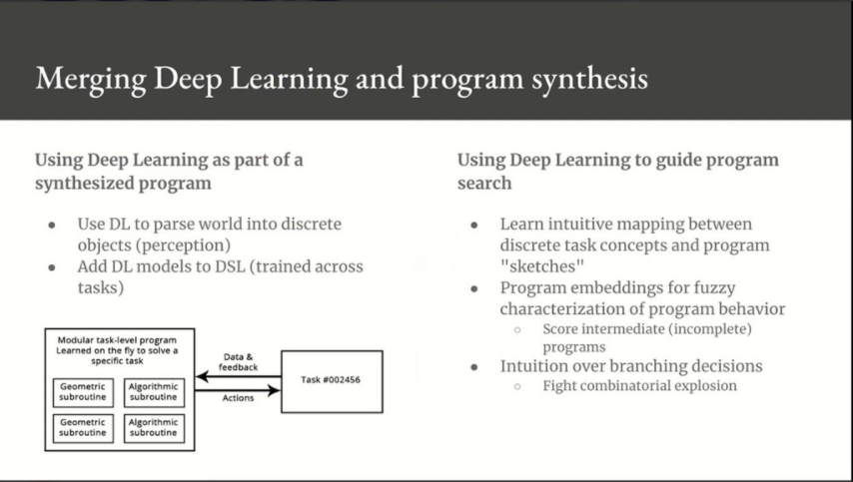
Notes:
Reasoning in humans is often drivent by high level intuition, and that’s the key to address the fundamental problem of program synthesis, which is the complexity that grows exponentially with program size.
And there are two exciting research areas to combine the strenght of deep learning with the strenghs of program synthesis.
The first is : discrete programs that integrate deep learning components.
The second one is : deep learning models that inform discrete search and improve its efficiency, instead of using hard-coded heuristics. This kinda assumes that the space of possible heuristics is an interpolative manifold on which you can do gradient descent.
So you can use deep learning in two ways.
You can use it as a kind of perception layer to parse a situation into discrete building blocks that you can feed to a program synthesis engine, you can incorporate deep learning as a building block of your DSL.
The second way is that you can use deep learning as a driver, as a guide, for program synthesis. That will give you intuitive program sketches to guide the program search, and that will reduce the space of possible branching decisions that you should consider over each node, and that’s pretty similar to the way humans write programs.
Engineers don’t program the way a program synthesis engine works today, engineers actually rely on a lot of intuitive pattern matching, which means they only have to explicitly reason about a small number of discrete cases.
In the future, I believe we’re gonna move towards hybrid systems that will combine deep learning and program search. It will be mostly program search, but it would be deep learning driven.

Slide 36
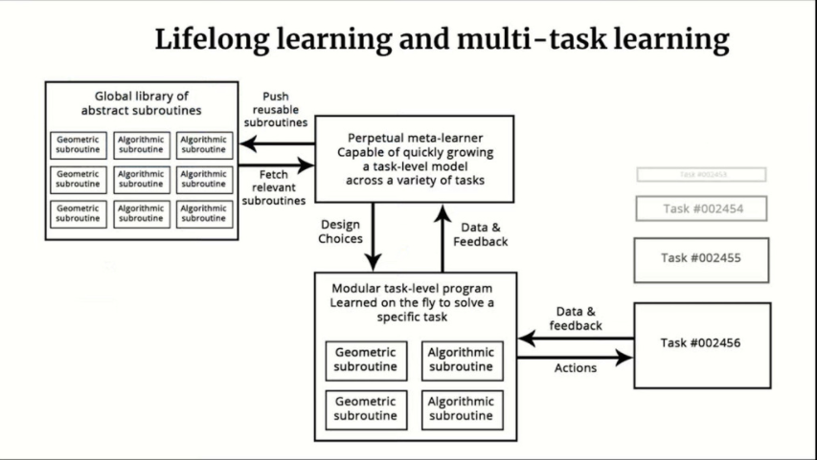
Notes:
This leads us to a long term vision for the future of AI and deep learning, that closely resembles the workflow of software engineers today when they’re writing software.
If you want to know how AI will operate in the future, I think you should just look at how human engineers operate today.
Engineers constantly manipulate abstract programs that were developed on a different task than what they’re currently doing and that sort of abstraction is really the Holy Grail of AI.
I think AI will be evolving along these lines, along the lines of creating new programs from an existing global library of abstract primitives that is going to be shared across many different problems, .
So you’d have a stream of tasks – you can imagine for instance that they’re ARC tasks – and for each task you will have a program synthesis engine that is capable of assembling a task-specific solution that will involve deep learning perception modules, so for instance parsing objects from the input grid of an ARC task, but also algorithmix modules.
And this task-specific solution program will be assembled by this program synthesis engine, which is basically a discrete search process, but it’s a dicrete search process that will be heavily guided by deep learning in terms of, for instance, providing intuitive fuzzy sketches of potentiel programs in order to reduce the size of the search space, also in terms of providing intuition about branching decisions when you’re doing op-level local search, intuition over how likely it is that a given program sketch or actual program will eventually match a given specification, so doing « partial program » scoring.
That is very similar to how reasoning in humans is heavily guided by intuition and perception.
This program synthesis engine will not just produce a solution program to your current task, it will also generate reusable building blocks as a by-product of the search.
Some of these building blocks will be deep learning modules generated by value-centric abstraction that are gonna be trained offline on lots of data.
Some of trhem will be algorithmic modules obtained via program-centric abstraction, by noticing graph isomorphisms in different functions inside the given program, and also acoss different programs.
All these building blocks will form an ever-growing DSL that is to be used as input to the programs synthesis engine.

Slide 37
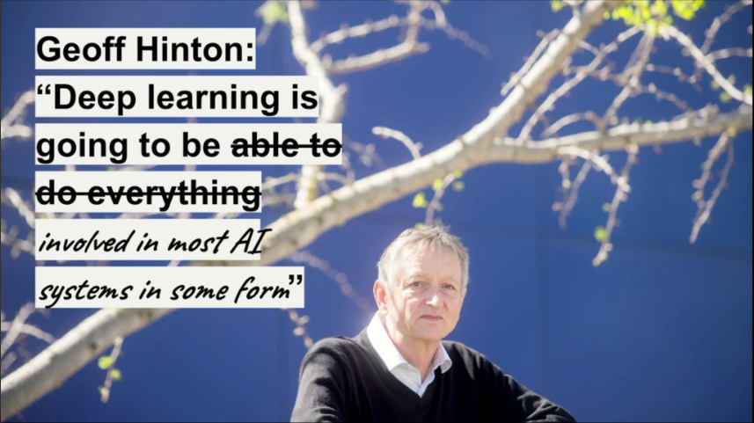
Notes:
In the future we’re gonna be moving towards lifelong-learning hybrid systems that combine deep learning and program search.
So you can say that deep learning will be involved in the various different solutions that we will be developing to various different problems.
It’s not going to do everything but it will be involved in pretty much everything.

Slide 38
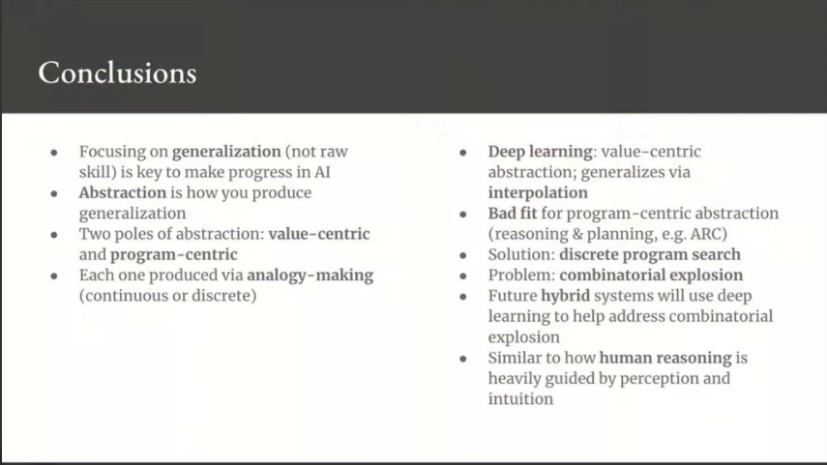
Notes:
So to conclude :
Generalization is really key to make progress in AI and abstraction is how you produce generalization.
There are two key types of abstraction : value-centric and program-centric.
Each type is produced by analogy-making and there’s a fundamental relation between abstraction and analogy : analogy is really the engine of abstraction.
At the origin of generalization in deep learning is interpolation, so it makes it a good fit for value-centric abstraction and geometric analogy making, but it’s a poor fit for program-centric abstraction.
We can’t use it for problems that require planning and reasoning and small sample sizes, such as ARC problems.
The solution to these problems is discrete program search, but the obstacle that you run into is combinatorial explosion.
Future hybrid systems will be able to use deep learning to help address combinatorial explosion by guiding the program search.
That’s very similar to how human reasoning is heavily guided by perception and intuition.

